Slide 1
Analyzing the Impact of Transport Layer Protocols on QoE in bilateral Teleoperation Capstone II
Chalasani Vineeth ,CS24MTECH11023
Guide: Prof. Bheemarjuna Reddy Tamma
Notes:
ID=d924773e-9a16-4d6d-9803-8cb819e99682 Recipe=text_billboard Type=TextOnly Variant=0 FamilyID=AccentBoxWalbaum_Zero

Slide 2
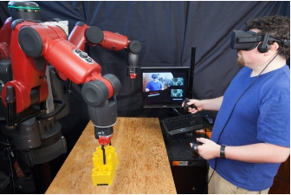
Introduction to Teleoperation
Teleoperation: Controlling a machine from a distance. You are here, the robot is there.
Telepresence: Feeling like you are actually at the remote location, even though you are miles away.
it allows us to do dangerous jobs safely without being there physically.

Slide 3
What is Bilateral Teleoperation?
Definition: Operating a complex system from a significant distance using a sensor-actuator feedback loop.
Bilateral Mechanism:
Forward Link: Operator sends motion/force commands to the remote robot.
Reverse Link: Robot sends visual, state, and haptic feedback back to the operator.
Use Cases: Telesurgery, Space exploration, Hazardous environments, and Rescue robotics.

Slide 4
The Challenge of Latency & Protocol Choice
Why Low Latency is Critical:
High latency disrupts the operator's perception and control loop, leading to "move-and-wait" behavior.
Delays cause motion sickness in immersive setups (VR/AR) and reduce task precision.
The Role of Transport Layer Protocols:
Networks are imperfect (jitter, packet loss, bandwidth fluctuations).
TCP (Transmission Control Protocol): Reliable, ordered delivery, but introduces delays due to retransmissions and congestion control
UDP (User Datagram Protocol): Fast, low overhead, no retransmissions. Prone to packet loss but prevents old, stale data from delaying new data.
Goal: To determine which protocol offers an optimal balance for a seamless Quality of Experience (QoE).

Slide 5

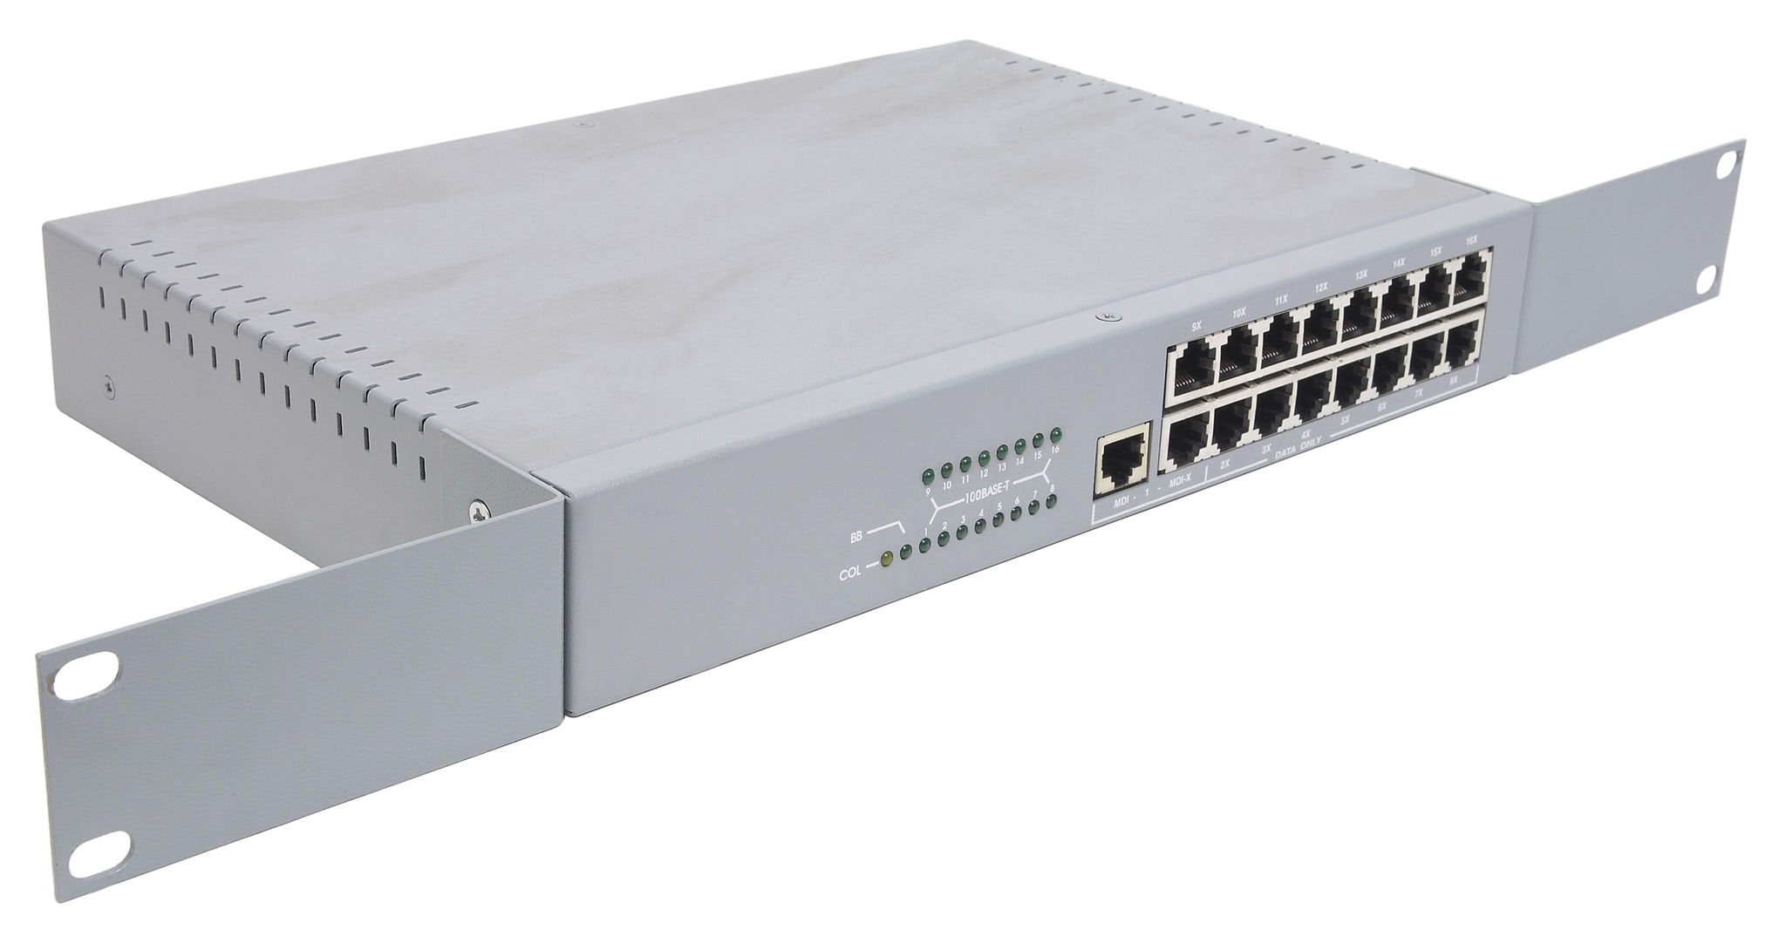
System Architecture
LAN as medium
LAN as medium
Switch
NVIDIA Isaac Sim (GPU)
Unity engine (Ubuntu Machine)
Server: Robot arm simulator
Client: DT version of Isaac Simulator

Slide 6
Flow Diagram
Network Emulator
Flow 1: State Packets from Robot simulator
Flow 2: Control Commands from DT
Network Emulator
IP: 10.9.71.137
IP:10.9.68.25
Server: Robot arm simulator
Client: DT version of Isaac Simulator
Port numbers for different flows :
Flow1:server:11020,Client: by OS
Flow2:server:11021,Client:11020
Flow of Packets in all the protocols
Acks in case of TCP as underline Protocol

Slide 7
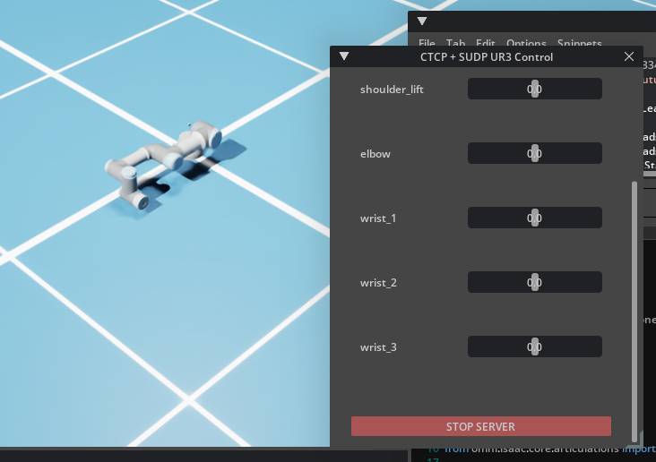
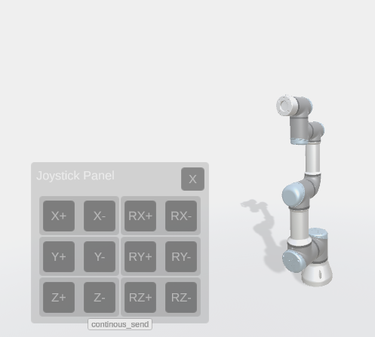
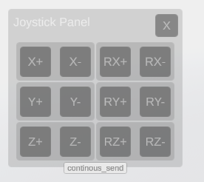
Corresponding action Updated
Command sent
Server: Robot simulator
State packet received
A button is pressed
The action seen in DT
Client side: Joystick Panel
An RTT is required
Client: DT of the robot simulator

Slide 8
Experiment Configuration & Parameters
Update Rates:
Robot State Packets (Server to Client): ~50 ms (20 Hz)
Command Packets (Client to Server): ~40 ms (25 Hz)
Experiment Duration: 1 minute 30 seconds per trial.
Trials:
Conducted 3 separate experimental runs for each protocol (TCP and UDP) to ensure statistical reliability.
Packet Sizes:
State Packet Size: [Insert actual size, e.g., ~240 Bytes]
Command Packet Size: [Insert actual size, e.g., ~150 Bytes]
Notes:
This is the most important section. Show what you've done.

Slide 9
Network Setup & Emulation
Dataset: Utilized a validated 4G/LTE network dataset.
Source: J. van der Hooft et al., Ghent University (IEEE 2016).
Emulation Tool: Linux Traffic Control (tc) / netem.
Application: Symmetrical network impairment applied at both the Client and Server endpoints to accurately emulate the specific bandwidth, packet loss, and jitter profiles observed in the LTE dataset.

Slide 10
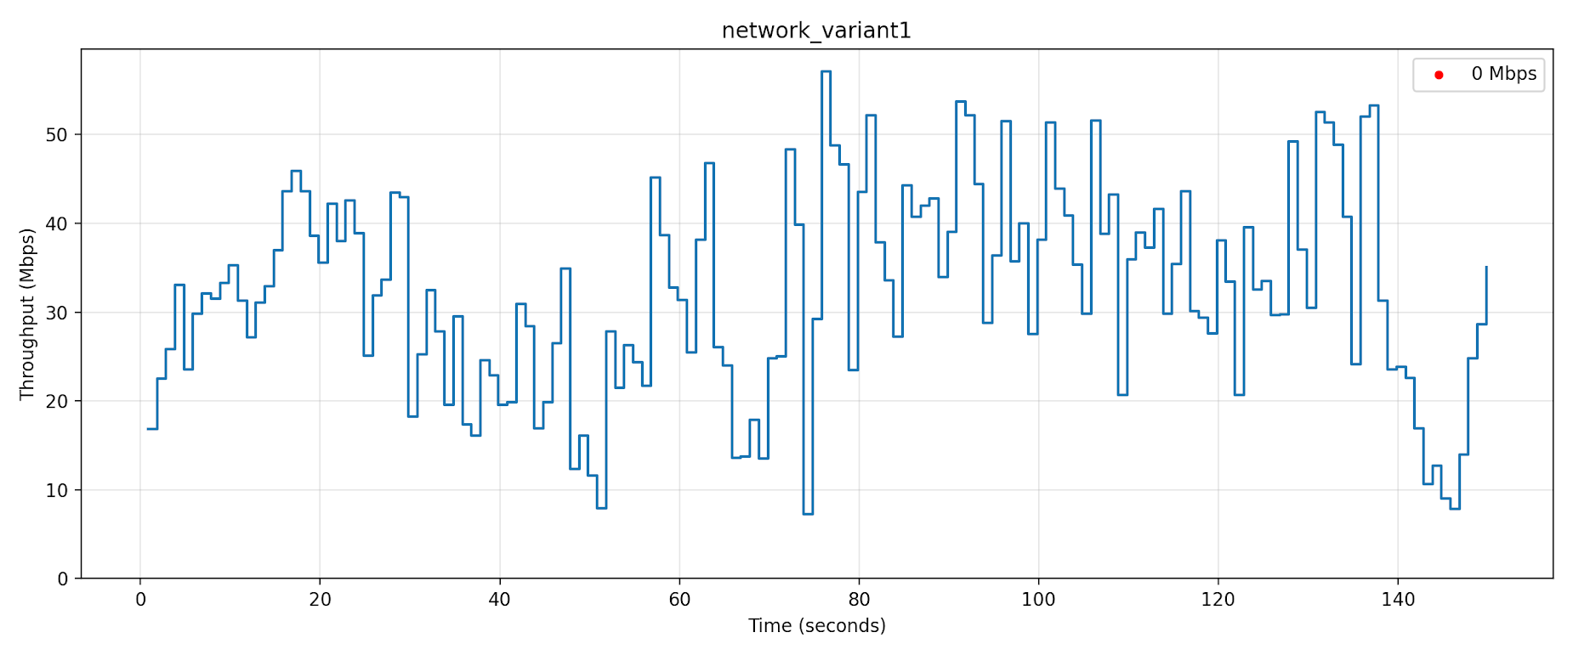
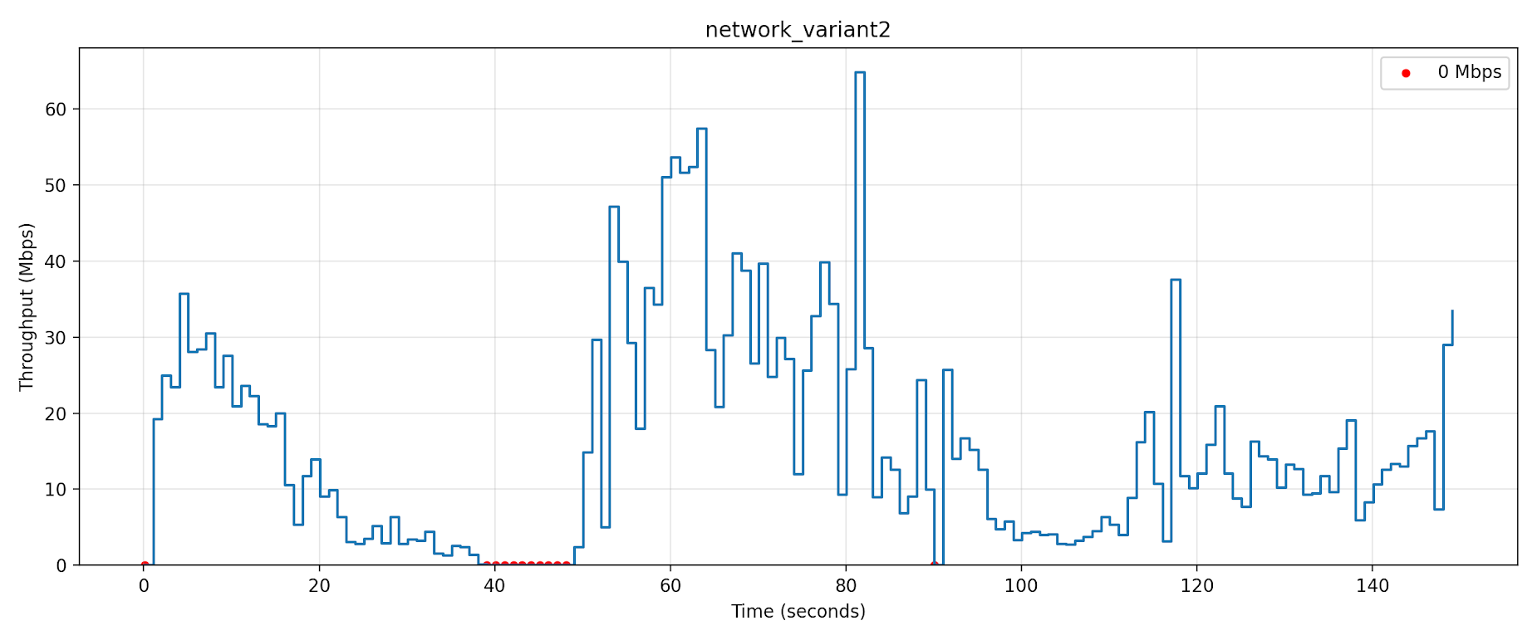

Slide 11
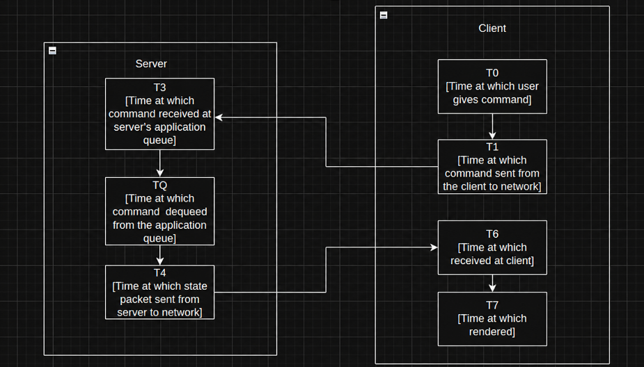
Timestamp flow diagram

Slide 12
Metric
Metric | Formula | Description
Control Loop Latency (CLL) | (T6-T1) | Command to feedback latency
AppBuffer Delay | (TQ-T3) | Server application queue wait
Processing Delay | (T4-TQ) | Simulator robot processing (Server)
Network RTT | (CLL-(AppBuffer+dProcessing)) | 2 way propagation delay and TCP/IP network stack delay
Rendering Delay | (T7-T6) | Client rendering latency
Motion-to-Photon Delay (MTP) | (CLL + dRendering) | Total user-perceived latency

Slide 13
Metric
Application Stalls:
Definition: Occurs when the client-side buffer is completely empty, causing the simulation to freeze or stutter.
Positional Drift:
Definition: The spatial error between where the client expects the robot to be (based on commands sent) and where the robot actually is (based on received state).
Packet Loss Evaluation:
Calculated bi-directionally by tracking missing sequence numbers relative to the highest received sequence number at both the server and client.

Slide 14
Results
 |  | UDP |  |  | TCP
 |  | BaseLine | Network variant 1 | Network variant 2 | BaseLine | Network variant 1 | Network variant 2
Latency | Control Loop Latency (CLL) | 20.77 | 24.31 | 25.71 | 17.835 | 17.751 | 23.513
 | AppBuffer Delay | 17.31 | 18.77 | 17.35 | 16.896 | 16.791 | 16.791
 | Rendering | 17.76 | 18.67 | 17.55 | 17.239 | 17.161 | 16.966
 | Processing Delay | 2.35 | 4.41 | 7.22 | 0.049 | 0.042 | 0.052
 | Network RTT | 1.1 | 1.12 | 1.14 | 0.939 | 0.961 | 6.777
 | MTP | 38.53 | 42.97 | 43.26 | 17.835 | 17.751 | 23.513
 | Jitter | 12.77 | 14.71 | 12.35 | 16.896 | 16.791 | 16.791
Packet Loss | Server to Client | 0 | 0 | 273.67 | 0 | 0 | 0
 | Client to server | 0 | 0 | 305. | 0 | 0 | 0

Slide 15
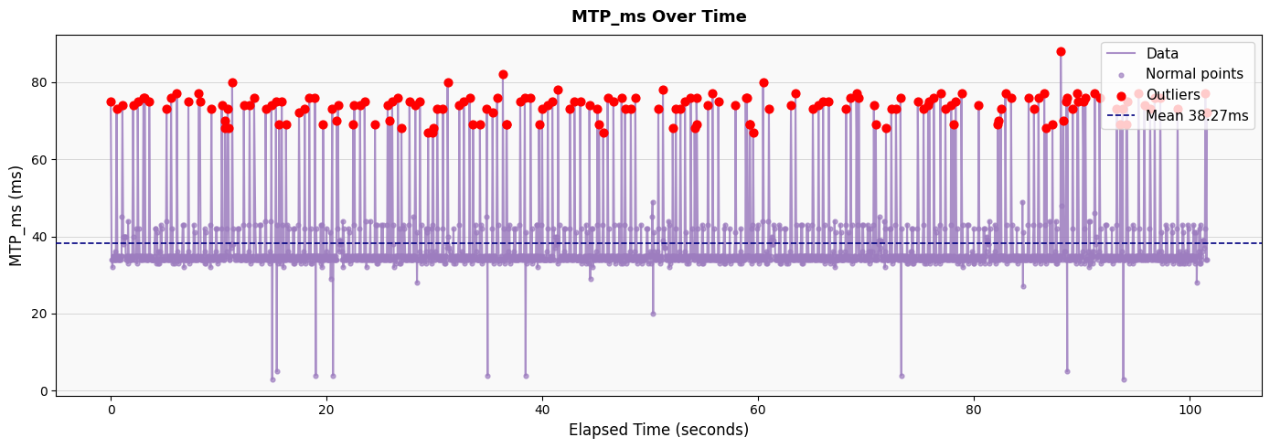
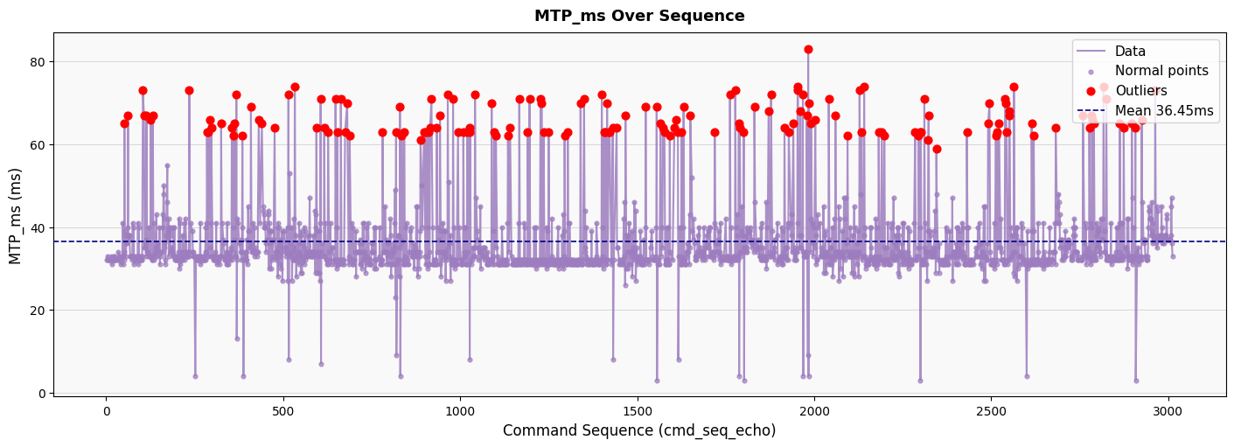
Results
UDP MTP_Plot
TCP MTP_plot

Slide 16
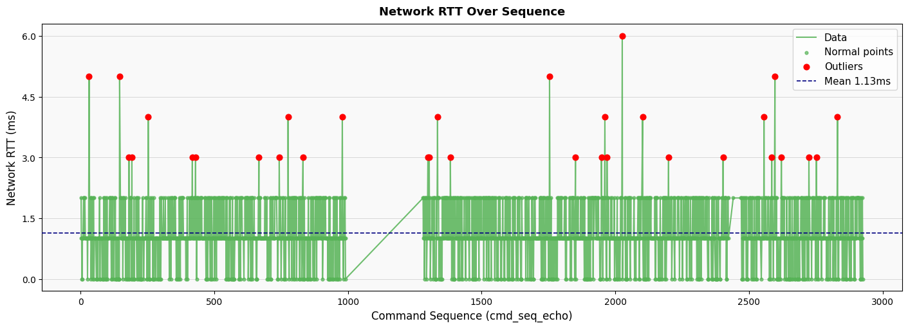
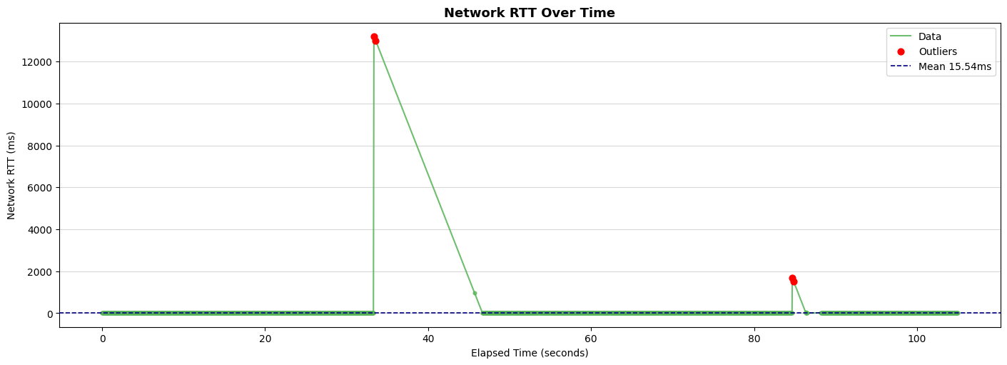
UDP network variant 2
Network_RTT
TCP_network variant 2 Network RTT
Key takeaway: UDP maintains significantly lower average latency compared to TCP under adverse network conditions, as it avoids the retransmission delays inherent in TCP's congestion control.

Slide 17
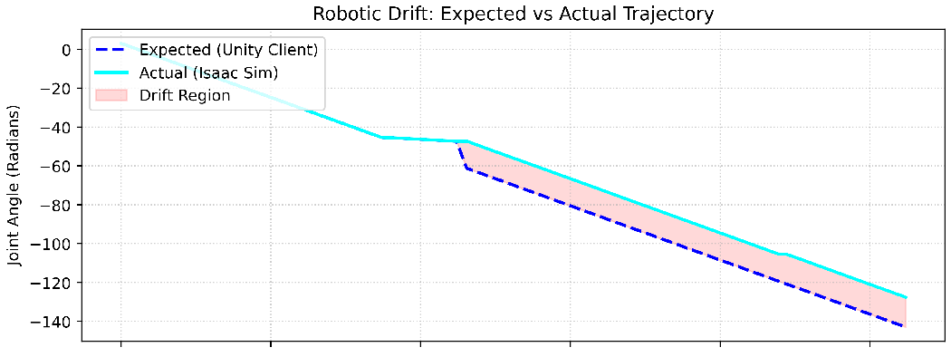
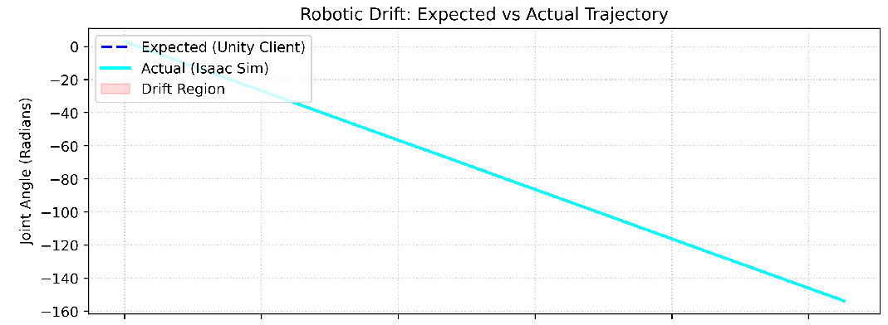
Drift Analysis
UDP_network variant 2
TCP_network variant 2
UDP exhibits significant position drift due to packet loss, making it unsuitable for teleoperations requiring high reliability. In contrast, TCP maintains zero drift, ensuring precise trajectory tracking.

Slide 18
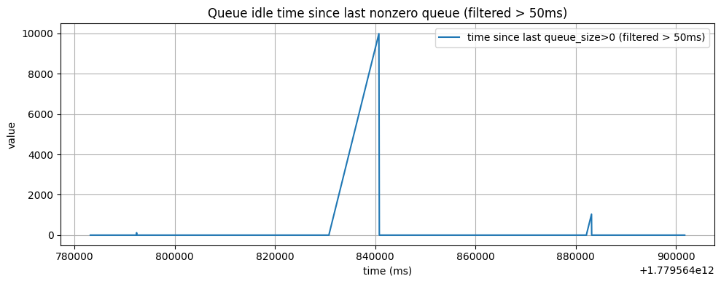
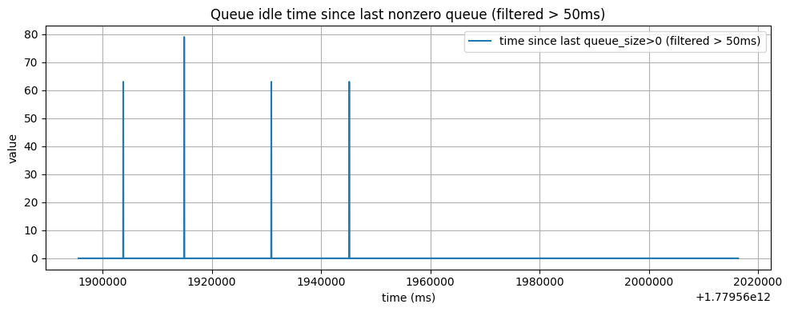
Stalls
Network variant 1
Network variant 2

Slide 19
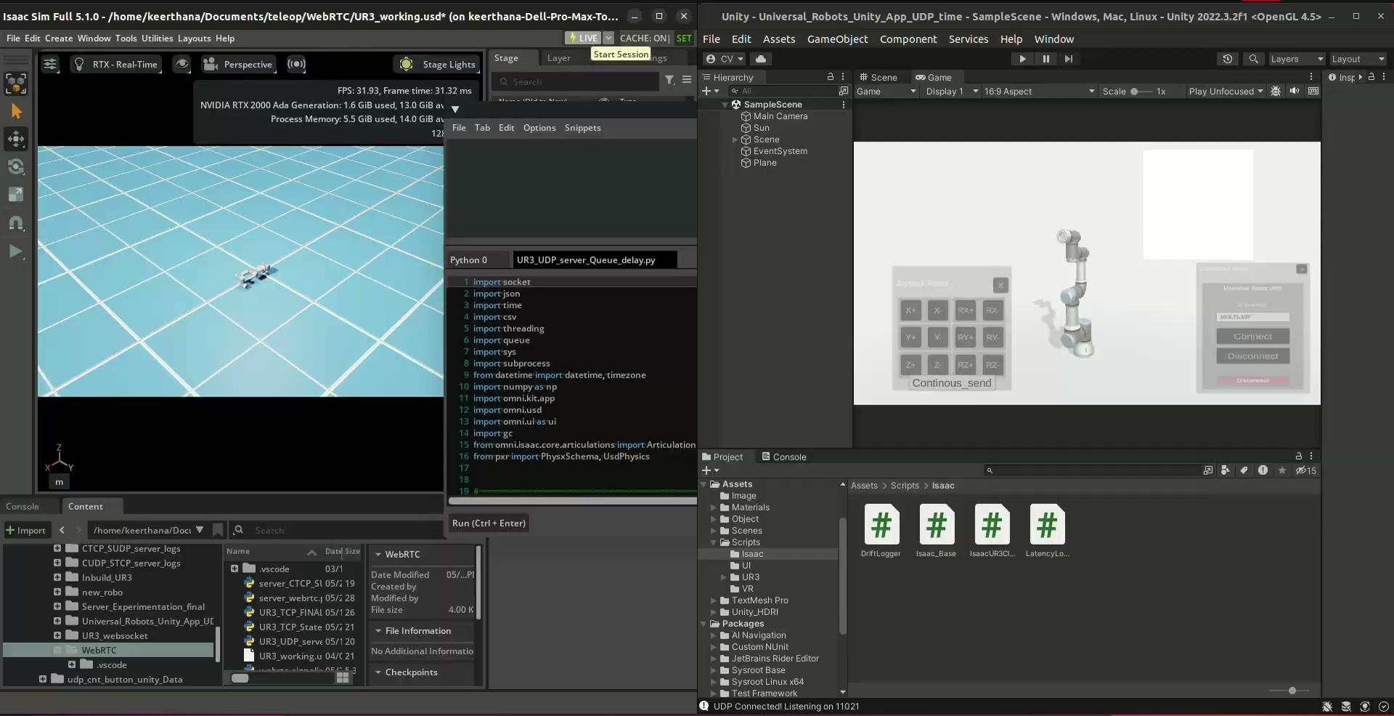
Live Demo

Slide 20
Observations: The TCP vs. UDP Trade-off
TCP (The Reliable Choice):
Strength: Guaranteed delivery ensured that every command reached the robot, resulting in minimal positional drift.
Weakness: Under network impairments, retransmissions caused Head-of-Line blocking, leading to compounded latency spikes and frequent application stalls.
UDP (The Fast Choice):
Strength: Continuous stream of data without waiting for acknowledgements resulted in consistently lower latency and minimal stalls.
Weakness: Packet loss meant dropped movement commands. This caused significant positional drift, breaking the synchronization between the operator's expectation and the robot's actual state.
Takeaway: Neither protocol alone provides an ideal Quality of Experience (QoE).

Slide 21
Proposed Solution: A Hybrid Transport Architecture
Commands (Client->Server) via TCP:
Why: Operator actions must be executed exactly as intended. TCP prevents dropped commands, effectively eliminating positional drift and ensuring safety.
State Updates (Server->Client) via UDP:
Why: Feedback (visual/haptic) must be real-time. If a state packet is lost, it is better to immediately render the newest state rather than waiting for a delayed retransmission of stale data.
Conclusion: This hybrid approach maintains the structural integrity of the teleoperation (no drift) while preserving the high responsiveness required for a seamless QoE.

Slide 22
References
J. I. Lipton, F. Alibaig, and D. Rus, "Baxter’s Homunculus: Virtual Reality Spaces for Teleoperation in Manufacturing," MIT CSAIL, Oct. 2017. [Online]. Available: https://thenewstack.io/human-workers-can-control-robots-virtual-reality-home

Slide 23
Thank You!

Slide 24
Packet Loss
 | UDP | TCP
Expected Count | 2706 | 2771
Observed Count | 2432 | 2771
Missing Count | 274 | 0
Packet Loss Percentage | 10.1256% | 0

Slide 25
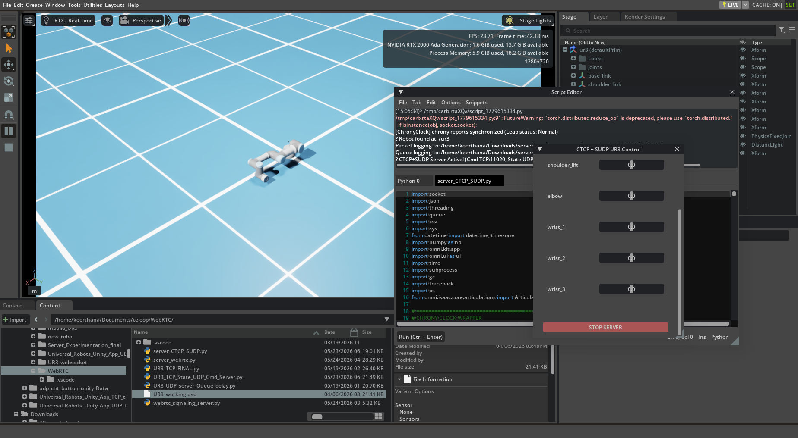

Slide 26
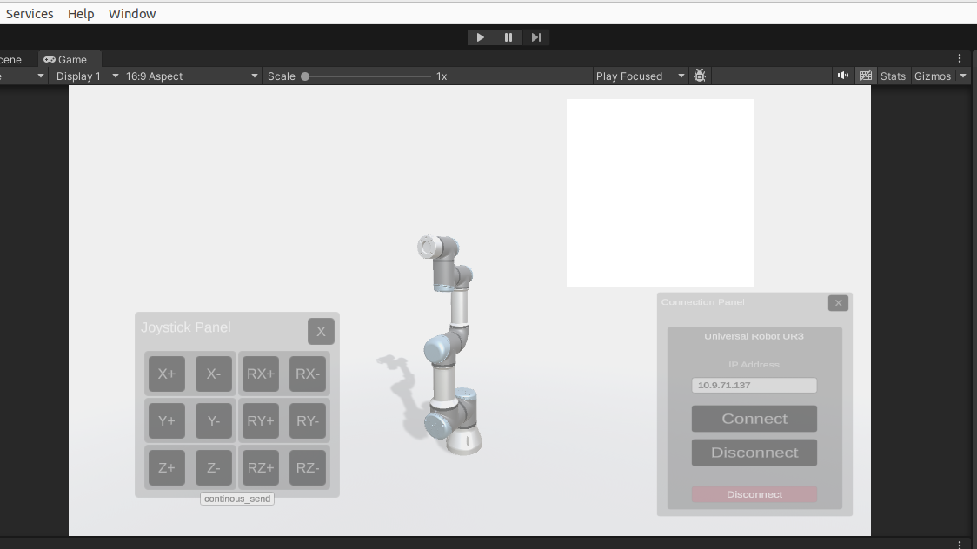

Slide 27
Metric
Command-to-State Latency: (T6−T1)
Total time from command dispatch to receiving the updated state reflecting that command.
Application Queuing Delay (Server): TQ−T3
Time a command waits in the server's application buffer before processing.
Network Delay: RTT−(Queuing+Processing)
The actual time spent in transit across the emulated 4G network.

Slide 28
Metric
Processing Delay (Server): T4−TQ
Time taken to execute the command on the UR3 and serialize the return state.
Rendering Delay (Client): T7−T6
Time from receiving the state packet to actively rendering it on the UI.
Motion-to-Photon Latency (MTP): RTT+Rendering Delay
The most critical metric for the user's perception of responsiveness.
Packet Loss Evaluation:
Calculated bi-directionally by tracking missing sequence numbers relative to the highest received sequence number at both the server and client.

